Slide 1
Clinic Management System

Slide 2
introduction:
The project is a site that manages the clinic easily, where the user can create some functions to make it easier for him to deal and go to the clinic

Slide 3
Project Scope:
This project can be used by any clinic that wants to make it easier for customers and reduce the labor that the doctor needs to manage the clinic

Slide 4
Some of the functions that can occur in the system are:

Slide 5
patient functions :-
login
Registration
Reservation(web site)
patientEnquiry

Slide 6
Admin Functions :-
Search(all data)
Update
login

Slide 7
Doctor functions: -
Add Admin
Enquiry (database)
Registration (dashboard)

Slide 8
We can represent the data, the relationship between the tables, and the relationship between the patient, the doctor, and the admin through an ERD diagram

Slide 9
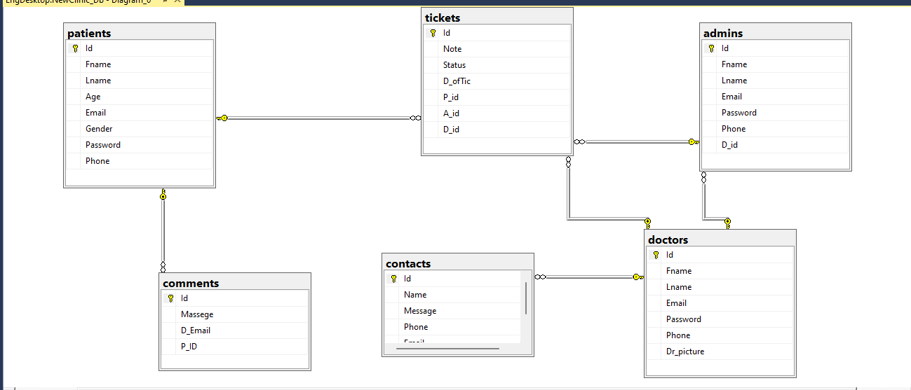
- Erd :-

Slide 10
The user can see some scenes by entering the site

Slide 11


Slide 12
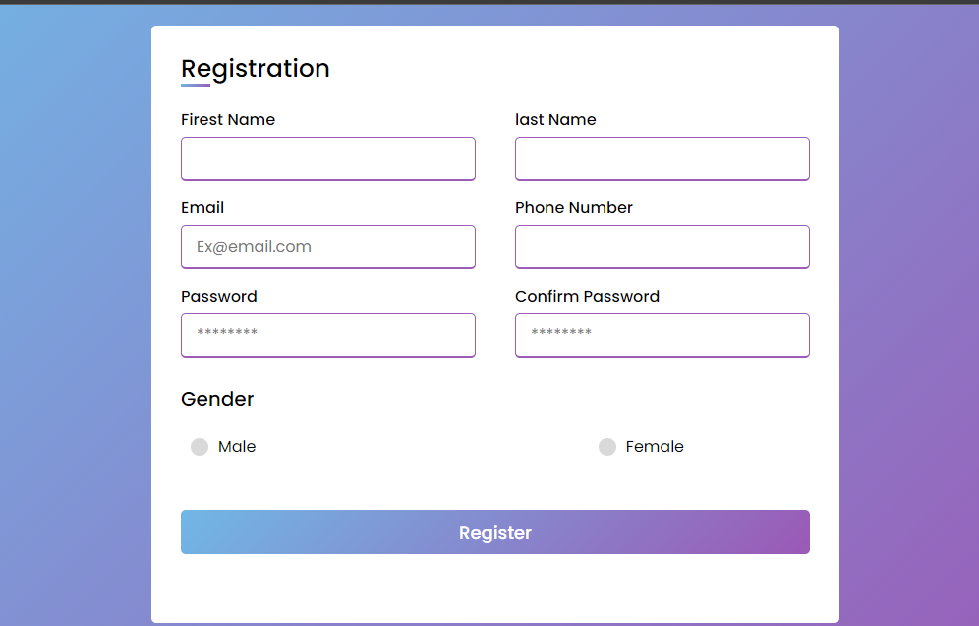

Slide 13
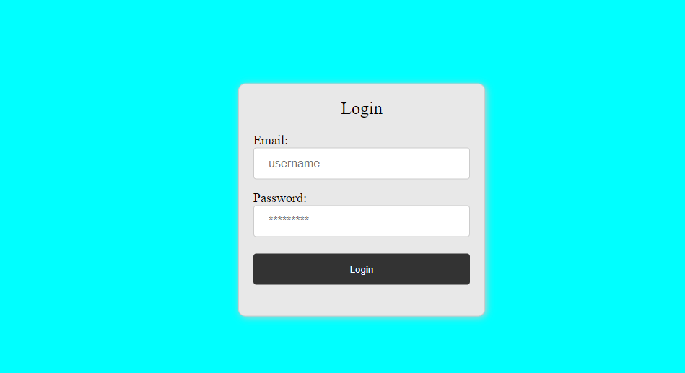

Slide 15
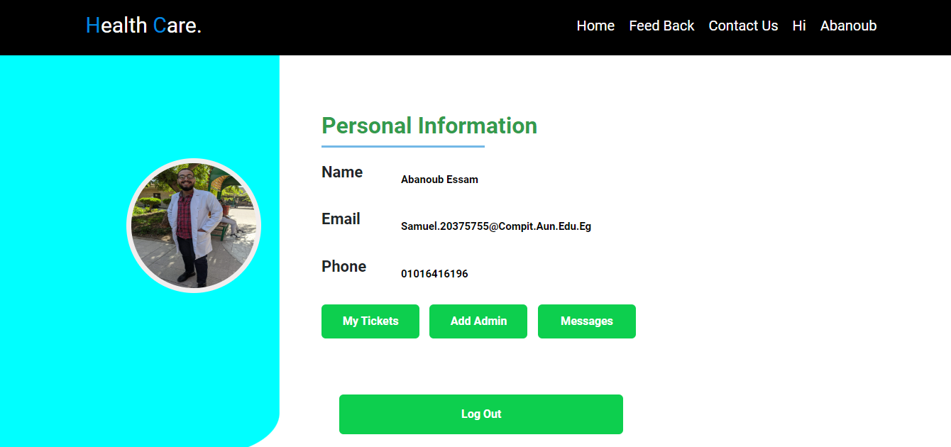

Slide 16
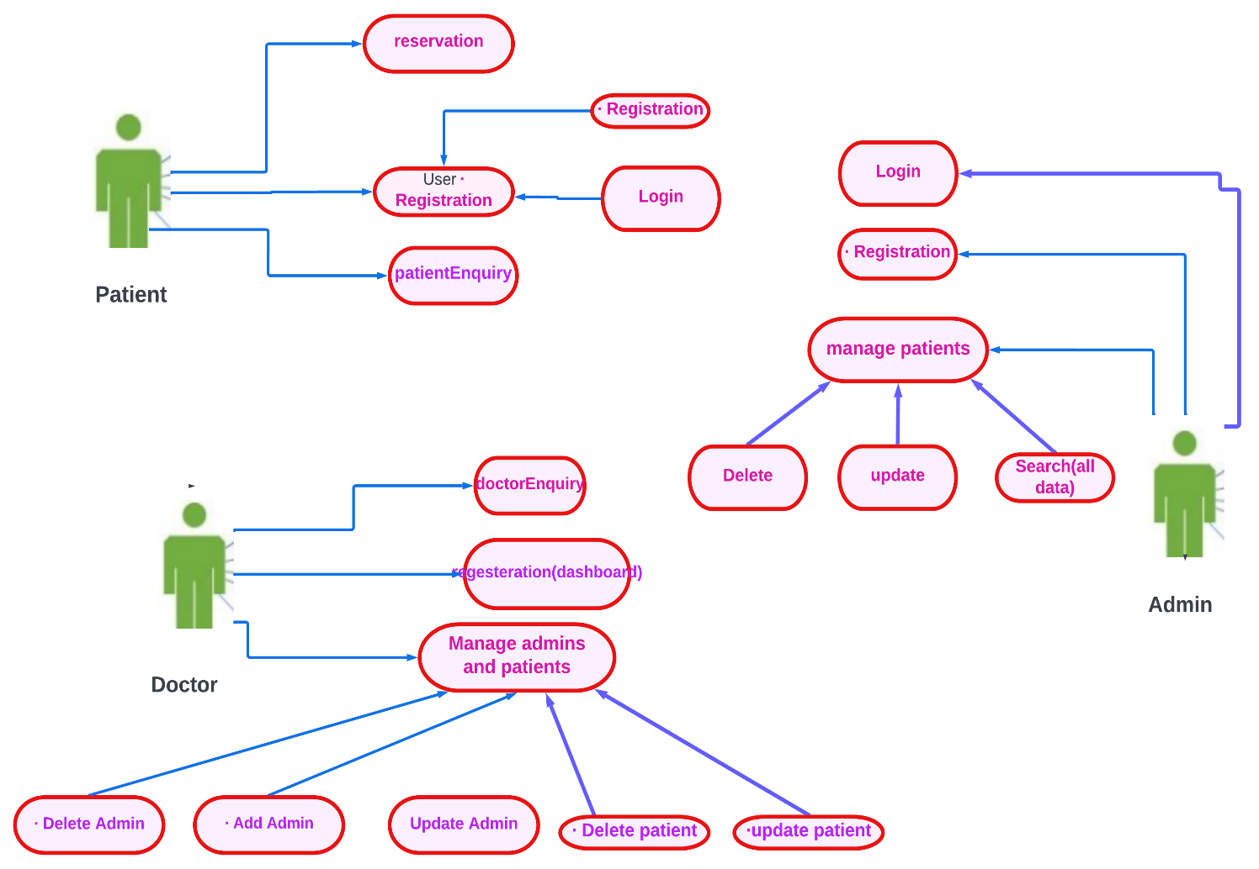
-Use Case Diagram:

Slide 17
Team Members : -
1- صموئيل مرزوق رزق
2- صديق حليم صادق
3- ابانوب عصام عياد
4- صبحي محمد صبحي
5- طارق عبدالعزيز

Slide 18
Thank You

